Slide 1
Machine Learning Approach for Quality Prediction
-: Kartik Kamboj

Slide 2
Introduction
Iterate until data is ready
Iterate to find the best model
Raw
Data
Apply preprocessing to data
Prepared data
Apply learning algorithm to data
Candidate model
Deploy chosen model
Raw
Data
Chosen model

Slide 3
Quality prediction
Quality prediction, in the context of machine learning and data analysis, refers to the process of using data and predictive models to anticipate the quality or performance of products, services, or processes.
Quality prediction can be applied across various domains, including manufacturing, financial services, banking sectors, and e-commerce and more.
Significances of quality prediction ,
Using historical data, organizations can identify patterns or predict the outcomes to help them in business growth.
It can help in tailoring marketing strategies, retain valuable customers.
The quality of the product can be improved and enhanced.
Better decision making by analysing data and providing actionable insights.

Slide 4
ML Algorithms in quality prediction
Training data
Unacceptable
Acceptable
Train ML algorithm
Accuracy
Successful Model
Model trained
New data
ML
Algorithm
Prediction

Slide 5
Use case
Fraud on Online Real Estate Platforms

Slide 6
Problem Statement
Fraudsters listing fake properties on the platform
Genuine buyers/renters get in touch with fraudsters
Fraudsters connect with these customers offline/directly
Leading to data theft and money scams

Slide 7
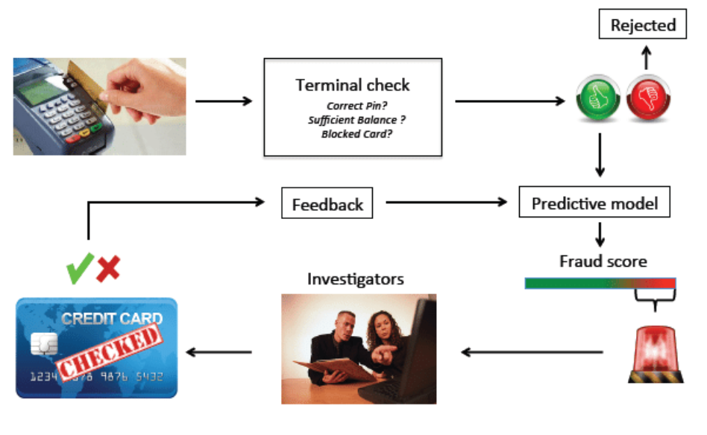
Fraud Detection and Prevention
Due to digitalization, there has been a lot of cashless transactions in recent years which has led to increase in fraudulent activities.
These activities can be done by skimming, hacking the details, fake wire transfers, fake emails.
To reduce and prevent these kinds of transactions, fraud detection frameworks are designed using Machine Learning Algorithms.

Slide 8
Sample Data inputs for the model
Time of publish of the listing
Price of the listing wrt the pincode/location
Time taken to fill the listing
Price vs Size of the apartment
Owner’s identity match (identity score)
Past record of this account
Fake/reused pictures

Slide 9
Listings Fraud Detection and Prevention Implementation
Split the labelled dataset into two different datasets of target variable and explanatory variables.
Split the two datasets into training and testing data.
Fit the Logistic regression model on training data and predict the data.
Predict the accuracy score on training data.
Predict the model with the test data and check the performance metrics.
If the performance matches, the data is generalised and good to proceed.

Slide 10
Model Predictions & Subsequent Actions
Fraud score
Depicts the likelihood of the listing to be a fake listing
Based on most important features determined as part of implementation
Listing publishing system takes action based on fraud score
The listing can directly go live
Listing is blocked
Listing is sent to a manual team for evaluation
Alignment with business on acceptable fraud on the platform
Blocking fake listings might contradict the actual business goals of more/faster listings on the platform
Make business team more aware of the fraud situation on platform

Slide 11
Model improvements
Retraining the model with live data
Train the model periodically based on changing fraud trends

Slide 12
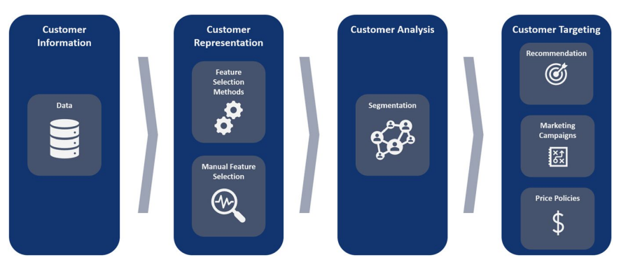
Segmenting, Personalization, and Targeting Customers in E-commerce
With the advent of one-customer strategies, traditional mass marketing is obsolete in this area.
When someone signs up, part of the demographic info., while searching and clicks all this an algorithm learns and determines and hence more relevant results.
The returns and how often do they make a purchase are also monitored and in return gives out offers, other discounts, relevant item bought.

Slide 13
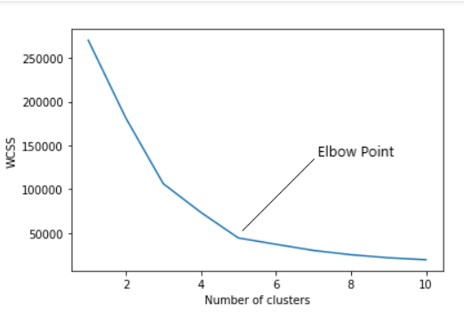
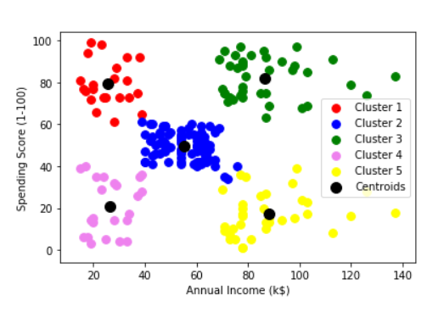
Segmenting, Personalization, and Targeting Customers in E-commerce
Implementation
K-means is the most used unsupervised method by partitioning the data points based on euclidean distance.
Optimal number of clusters can be found using Elbow method using Kmeans library.
Initialize K-Means model with selected optimal number of clusters
Visualize the clusters.

Slide 14
Case Study: Automatic Tuning of Machine Learning for Robust and Reliable Anomaly Detection
Finding anomalies using unsupervised algorithm.
Automatic tuning of hyperparameters of the algorithm using Flaml library.
Compare the AUC scores of 10 test datasets using default and suggested parameters
Training datastes
Testingdatastes
Test:
Features, samples
Default parameters
Tuned
parameters
Default parameters
AUC score's of default parametrs
AUC
score's of
tuned
parametrs
Train:
Features, Samples
Central tendency (mean, median and mode)
Compare
AUC score's of best parameters
AUC score's of default parameters
Compare

Slide 15
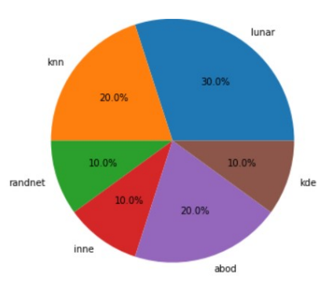
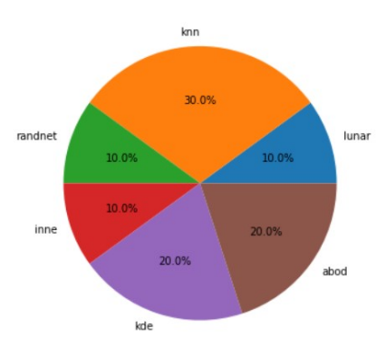
Results and Conclusion of the case study
The optimum algorithm with default and tuned hyperparameters given below.
Hyperparameter tuning, especially catered towards the dataset and not generalised, leads to better scores.
Default parameters
Best parameters

Slide 16
References
Ileberi, E., Sun, Y. & Wang, Z. A machine learning based credit card fraud detection using the GA algorithm for feature selection. J Big Data 9, 24 (2022). https://doi.org/10.1186/s40537-022-00573-8
Alves Gomes, M., Meisen, T. A review on customer segmentation methods for personalized customer targeting in e-commerce use cases. Inf Syst E-Bus Manage (2023). https://doi.org/10.1007/s10257-023-00640-4
Rakshit, S., Clement, N., Vajjhala, N.R. (2022). Exploratory Review of Applications of Machine Learning in Finance Sector. In: Borah, S., Mishra, S.K., Mishra, B.K., Balas, V.E., Polkowski, Z. (eds) Advances in Data Science and Management . Lecture Notes on Data Engineering and Communications Technologies, vol 86. Springer, Singapore. https://doi.org/10.1007/978-981-16-5685-9_12

Slide 17
Thank you !

